Slide 1
Open CA, Python program Instructions Manual, version 1.0.0.
!UNDER DEVELOPMENT!
Author: Andraž Kocjan, June 2023
!UNDER DEVELOPMENT!

Slide 2
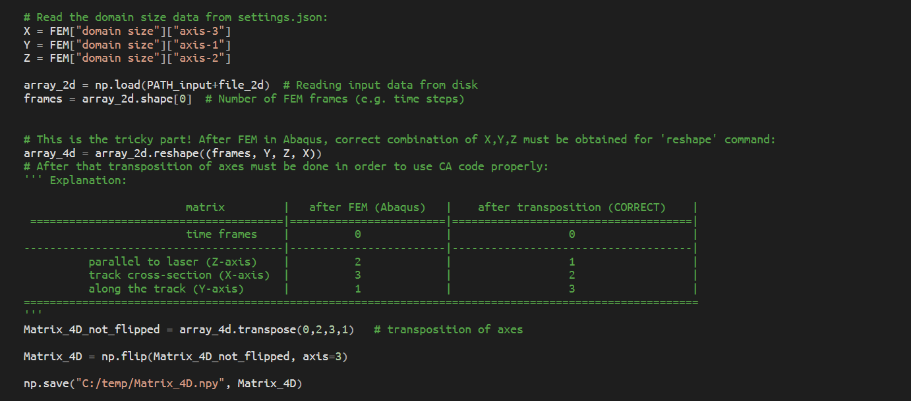
After setting up the environment with .exe program for interpolation, place the FEM .NPY file after FEM in the
INPUT_data folder. Then run the matrix_interpolation_wenrui.py, which will do reshaping, transposing and
flipping and finally saving this input matrix as Matrix_4D.npy in C:\temp folder. (Make sure you have one)

Slide 3
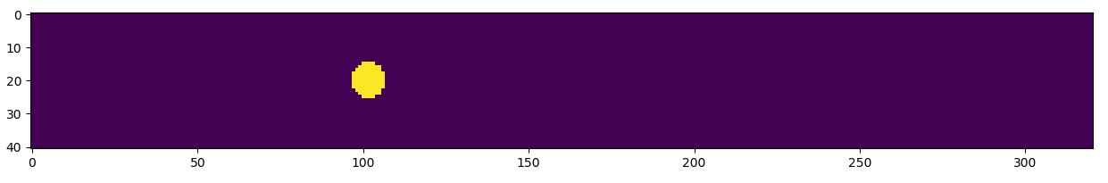
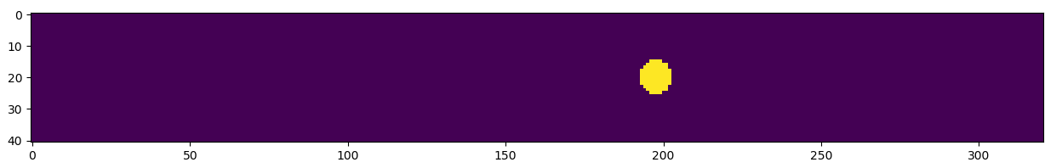
X
Melt-pool in raw domain after FEM at 600 K, X-Y plane projection
Time step = 0
x_min = 14
y_min = 95
y_max = 210
Time step = 48
x_min = 27
Y
Diminishing FEM domain to a size to capture melt-pool only,
taking 1 (top) Z layer only, since this is 2D CA.
Python code to get upper images:
import numpy as np
import matplotlib.pyplot as plt
plt.ion()
q=np.load('C:/temp/Matrix_4D.npy')
plt.imshow(q[0,0]>600) # 1st zero for time step=0, 2nd for top Z layer
# uncomment this to get the final step melt-pool image
# plt.imshow(q[48,0]>600)

Slide 4
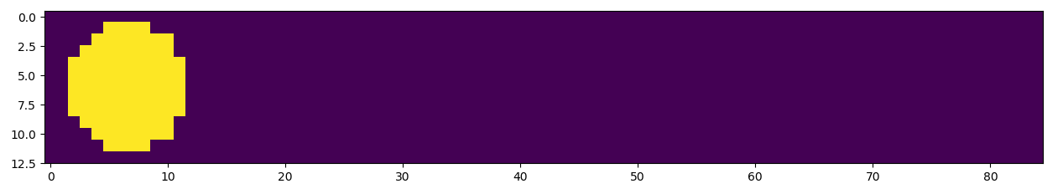
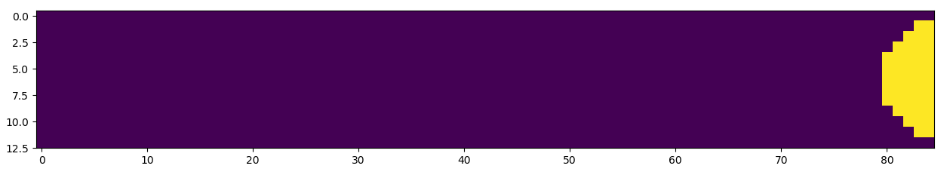
Diminished domain – BEFORE intepolation
Time step = 0
Time step = 39
Python code to get upper images:
import numpy as np
import matplotlib.pyplot as plt
plt.ion()
q=np.load('C:/temp/Matrix_4D.npy')
plt.imshow(q[0,0, 14:27, 95:180]>600) # time step = 0
plt.imshow(q[39,0, 14:27, 95:180]>600) # time step = 39

Slide 5
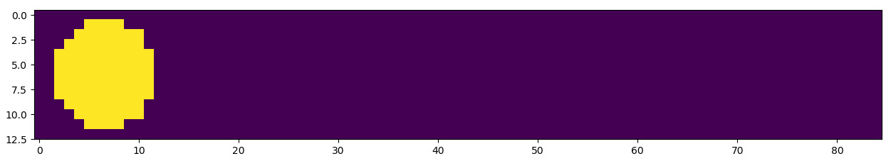
Why do we need long track (interpolation and CA) and what does it even mean?
To get better resolution we need to do interpolation of upper 2D temperature (phase) matrix. But when you do
this you instantly get very large objects, which RAM during CA on normal computers can‘t handle. Therefore, we need to cut upper domain into several EQUAL sized sub-domains and perform CA on each of these:
YP0
YP1
YP2
YP12

Slide 6
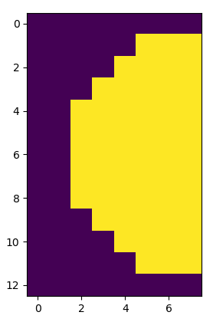
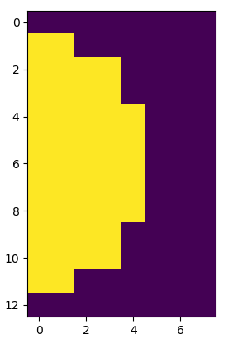
ΔY=8
BEFORE interpolation
ΔX=13
plt.imshow(q[0,0, 14:27, 95:103]>600)
sub-domain YP0
time step = 0
sub-domain YP1
time step = 0
plt.imshow(q[0,0, 14:27, 102:110]>600)
ΔY=8
Δx=13

Slide 7
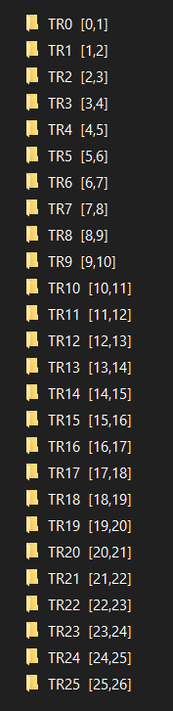
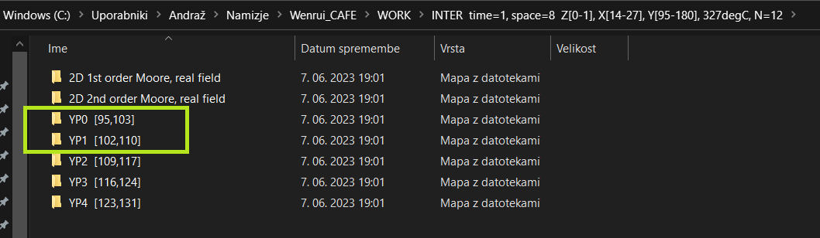
matrix_interpolation_wenrui.py in long_track = True mode does the job of cutting down diminished domain into
EQUAL size sub-domains, peforms the interpolation according to interpolation factor given in settings.json file.
In demo case this factor is 8, which means that mesh cell size will decrease from 50 μm to 6.25 μm.
In order to preserve continuity of space and time there are also 8-time more time frames as
the mesh cell size is diminished for 8-times. Thus, time steps of each sub-domain (YP) are
saved in separate folders:

Slide 8
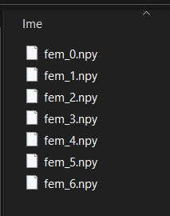
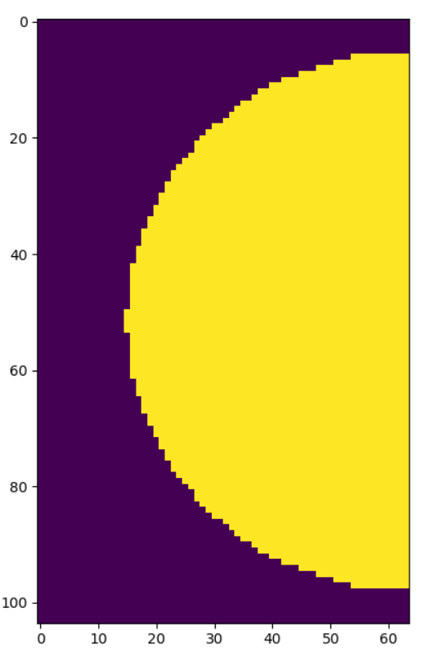
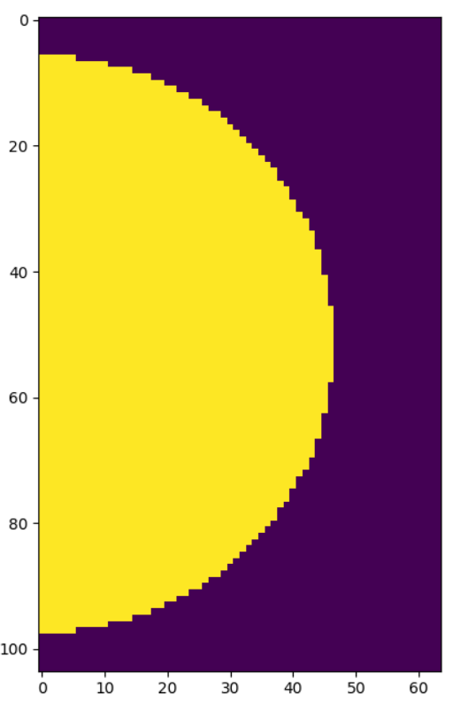
In each time step folder there are
interpolated matrices named as fem_{}.npy
ΔY=8 * 8
..\YP1 [102,110]\TR0 [0,1]\fem_0.npy
ΔY = 64
ΔX=13 * 8
ΔX = 104
8 is interpolation factor,
defined in settings.json
..\YP0 [95,103]\TR0 [0,1]\fem_0.npy

Slide 9
